Slide 1
Investigating Grant Allocation Disparities from a Gender Perspective

Slide 2
IS IT A LOTTERY?
IMPROVING GENDER FAIRNESS IN RESEARCH FUNDING
First GRANteD Conference
24th of February 2020 – Haus der Forschung
Sensengasse 1, 1090 Vienna
Twitter #GrantedConference

Slide 3
10:00 Opening address: Klement Tockner, president FWF Welcome: Wolfgang Polt, JOANNEUM RESEARCH
10:15 »The GRANteD Project: How gender bias in research funding is analysed«, Helene Schiffbänker, JOANNEUM RESEARCH, Coordinator
»Studying gender bias in grant allocations: the ERC case«, Peter van den Besselaar, TMC
11:00 Coffee Break
11:15 Keynote 1: » Experimental approach: Using lottery in allocating funding «, Ulrike Bischler, VW Foundation
12:00 Elevator Pitches: Alternative approaches for allocating grants (NWO, FWF)
12:10 World Cafe 1: Selection process – peer review
13:30 Lunch Break
14:30 Keynote 2: » Academics as superheroes: How the exceptionally masculine occupational stereotype in academia affects women (and men) «, Ruth van Veelen, Utrecht University
15:20 Coffee Break
15:45 Elevator Pitches: Existing tools for addressing gender bias (Vienna Business Agency, Eindhoven University, FFG)
16:00 World Cafe 2: Gender bias in peer review processes
17:15 Wrap up & Outlook
17:30 Networking – Snacks & Refreshments

Slide 4
Measure
Position paper “Room for everyone’s talent: Towards a new balance in the recognition and rewards of academics”
First implemented: November 2019
Presenter: Dr. Channah Herschberg, Dutch Research Council (NWO)
Aim, reason for implementation: Changing / modernizing the system of recognition and rewards. Currently: lack of balance in the appreciation of key areas in academia (education, research, impact, leadership). One-sided emphasis on research performance.
Description: Cooperation between the Dutch Association of Universities, Federation of University Medical Centres, the Dutch Research Council and other parties in the Netherlands.
Efforts within the Dutch Research Council so far:
DORA declaration:
No use of h-indices and journal impact factors;
Consider the value and impact of all research outputs (including datasets and software) in addition to research publications.
Rewarding a diversity in career paths and profiles for academics.
Narrative CV format: showcasing diverse types of talent, assessment of quality over quantity.
Calculation of formal research time.
cultural change needed!
Notes:
Narrative CV format: two categories: Academic profile and Key output.
In the Academic profile the applicants highlight their research focus and vision. They describe their position in their (inter)national academic field, their motivation for conducting research and, for the project in particular, the academic and societal potential of their work.
The Key output section allows a maximum of ten output items. The applicant explains the importance of each output, how it is related to the project, and/or how it shows the applicant’s abilities. Diverse types of output are allowed, ranging from journal articles and books, data and software, to exhibitions and performances. Preprints are also allowed. Special attention is paid to contributions to open science; candidates are required to indicate which outputs are openly available.
publication lists are often longer and total citation numbers are higher for male than female scholars. H-indexes can be gender biased and inflated by self-citation.
We ask applicants to calculate the formal time spent on research since obtaining their PhD. If an applicant has a full-time research appointment, more indications of (research) quality are expected than from an applicant with a similar PhD date, but an 80 percent teaching position.

Slide 5
Measure
1000 Ideas Programme – lottery
first implemented:
06/2020
Presenter: Tina Olteanu, FWF – Austrian Science Fund
Aim: Promotion of radically new and risky as well as particularly original research ideas that are beyond the current scientific understanding Reason for implementation: (1) traditional evaluations based on international peer review could be biased as feasibility is generally important and as well as sensible use of limited resources; this can lead to less risky funding decisions; (2) within this program, it is difficult to draw the line between original/risky ideas – what is more original or riskier than the other?
Description:
Selection of a pool of projects worthy funding: Ranking of all projects by an interdisciplinary international jury according to the objectives of the program (transformative potential of the research idea, feasibility of the proposed research approach, coherence and strength of the overall research proposal):
Selection by the jury: (max.) 15 best applications from this pool
Drawn at random: a further max. 15 applications from this pool
Applicants will not be informed whether their project has been selected by the jury or drawn at random. Deadline for applications was January 15th 2020. The first lottery will be held in June 2020.

Slide 6
IS IT A LOTTERY?
IMPROVING GENDER FAIRNESS IN RESEARCH FUNDING
First GRANteD Conference
24th of February 2020 – Haus der Forschung
Sensengasse 1, 1090 Vienna
Twitter #GrantedConference

Slide 7
Elearning tool: anti (gender) bias
First implemented:
2020
Presenter: Karin Dögl, Vienna Business Agency
Aim, reason for implementation:
equal chances for all applicants
better decision making
Description:
e-learning tool
3 modules á 15-20 questions (appr. 2 hours)
all board members who evaluate projects
no anti-bias training >> no evaluation
focus on gender bias,
but not exclusively

Slide 8
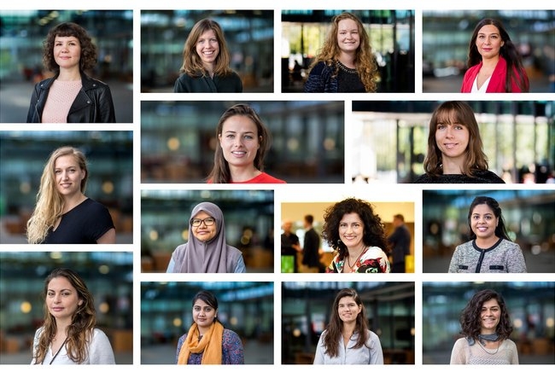
Measure
Irène Curie Fellowship
https://www.tue.nl/en/working-at-tue/scientific-staff/irene-curie-fellowship/
First implemented: 07/2019
Starting date: 07/2019
First implemented:
Presenter: Sandra Hesping, Eindhoven University of Technology (TU/e)
Aim: This program is aimed at talented women who pursue an academic career at TU/e. Reason for implementation: Fair: equal opportunity; Better science and technology Urgent need for more engineers, cannot afford to miss out on 50% of talent
Description: TU/e opens vacancies for assistant, associate and full professor exclusively for female talent during the first six months of recruitment. After 6 months: male and female candidates assessed; if equal: female is hired Offer Tenure track position of 5 years, Start-up package + 100 k€ (ICF), Academic independence, Dual career program, Mentoring scheme (ICF) What has been achieved so far? 60 ICF vacancies 20 hires (3 Full Prof. 17 a/a Prof.) Recruitment office, talent attraction team, Pipeline

Slide 9
Measure
Gender Criteria in the selection process
First implemented:
2009 / 2011
Presenter: Alexia Bumbaris, FFG
Aim, reason for implementation:
Fight gender bias
Improve quality of research
Description:
If the research concerns human beeings or the potential use of the research results by human beeings is given, the project design hast to take that into account → gender criteria
Criteria: „Quality of planning“ (state of the art in research, methods, market)
Criteria: „Suitability of applicants“ (gender balance in teams, gender mainstreaming)
Communication of gender criteria : providing information for and personal briefing of applicants, reviewers and jury members, stake holders
Internal communication of gender criteria: providing information, training of FFG staff

Slide 10
Thank you for your Attention!

