Slide 1
Gender differences in grant allocation: methods and findings
Peter van den Besselaar & Charlie Mom
TMC Research Amsterdam - Vrije Universiteit Amsterdam
Presentation for the 2nd GRANteD Conference - October 19, 2023

Slide 2
Acknowledgments
This presentation uses the following material from the GRANteD project
D2.1: Theoretical framework
Van den Besselaar, Mom, Möller; Cruz-Castro, Sanz-Menendez
D3.3: Grants and careers
Sandstrom; Mom, Van den Besselaar, Möller
D4.1: Indicators
Van den Besselaar, Mom, Möller; Sandström; Cruz-Castro, Sanz-Menendez
D4.2: Case studies in grant evaluation
Van den Besselaar, Mom, Möller; Cruz-Castro, Sanz-Menendez; Sandström
D4.3: Overview of the cases
Möller, Van den Besselaar, Mom
D6.2: Using linguistics to analyze grant evaluation
Van den Besselaar, Mom

Slide 3
Outline
The research questions
Relevant variables and indicators
Studying gender bias
Results from the quantitative case studies
Conclusions
Further work

Slide 4
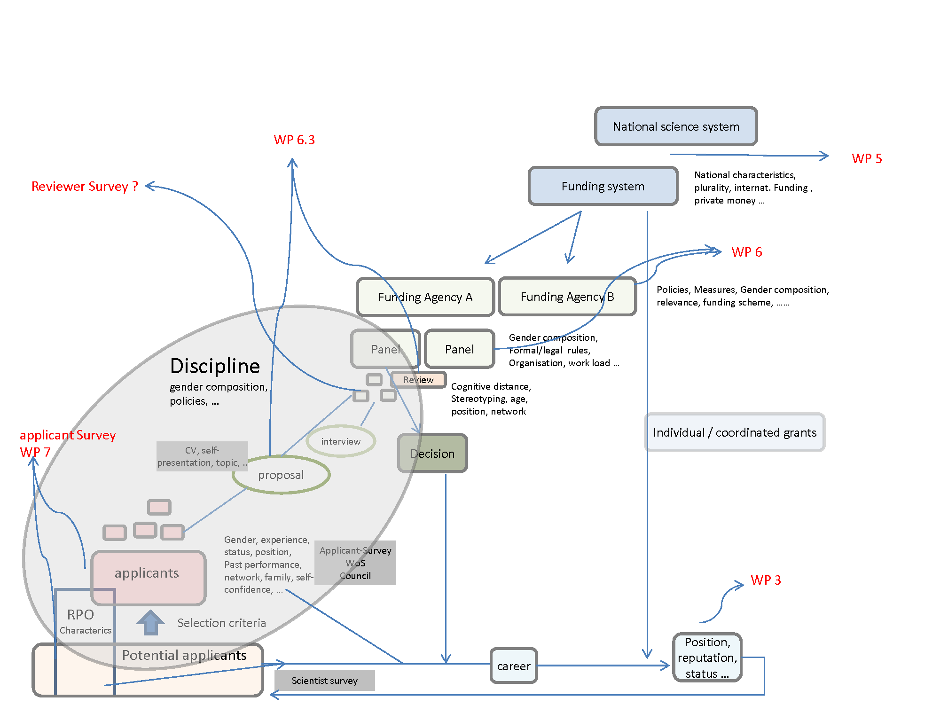
1. The research questions of GRANteD
Gender bias in
The application process?
Panel evaluation and decision-making?
Careers?
If so, what are the causes?
Gender policies of RFOs
Effect of national/org context?
Which were implemented?
Have these had effect on bias?

Slide 5
2. Criteria mentioned by reviewers / panelists
Explicit and operational criteria are needed
Otherwise: subjectivity!

Slide 6
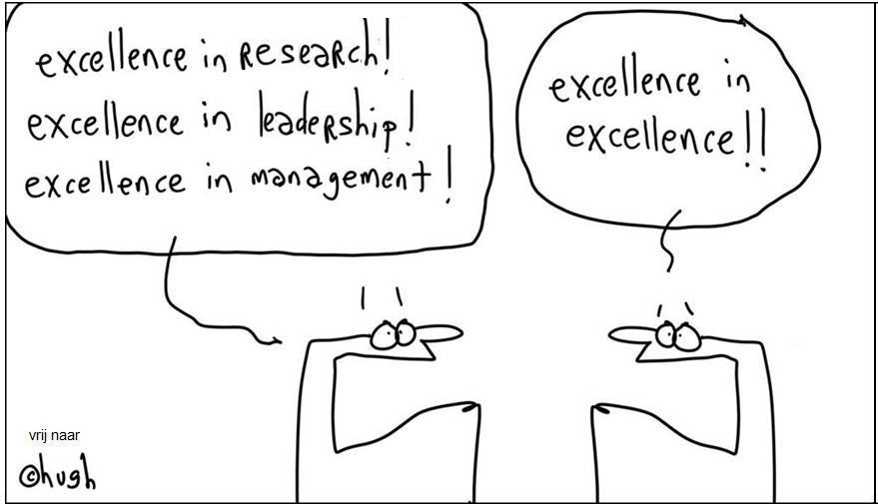
Merit and other criteria
Science is a merit-based system (and should be as much as possible):
Merit is a broad concept
For grant allocation, contributions to scientific knowledge are dominant
What about the role other (merit) dimensions?
independence
broad research agenda – cognitive mobility - interdisciplinarity
success in grant applications
ability to lead a research group
being social, team player
……..
Often unobservable
Definition, operationalization, validation of criteria & data collection

Slide 7
What is gender bias?
One needs to have operational selection criteria
Merit, skills, experience, relevant personal characteristics
Bias is deviation from the selection criteria
Non-merit criteria may introduce bias
If gender affects the evaluation, after controlling for relevant criteria = gender bias
Explicit and operational criteria are crucial
Good criteria (indicators) act against bias (Kahneman et al, Noise. A flaw in human judgement. 2021)
Notes:
Should be provided by the decision maker
If taken seriously, the decision maker needs to collect (through e.g. the CV) data to measure whether and to what extent the applicants fulfill those criteria.
Agreement by the community
Without that selection processes suffer from bias, noise, arbitrariness

Slide 8
Work on (new) indicators
Better way to measuring scientific contributions
Bias in awards and recognition
Independence
Cognitive mobility
Gender stereotyping
Self-presentation
Deliverable 4.1 contributions to developing indicators

Slide 9
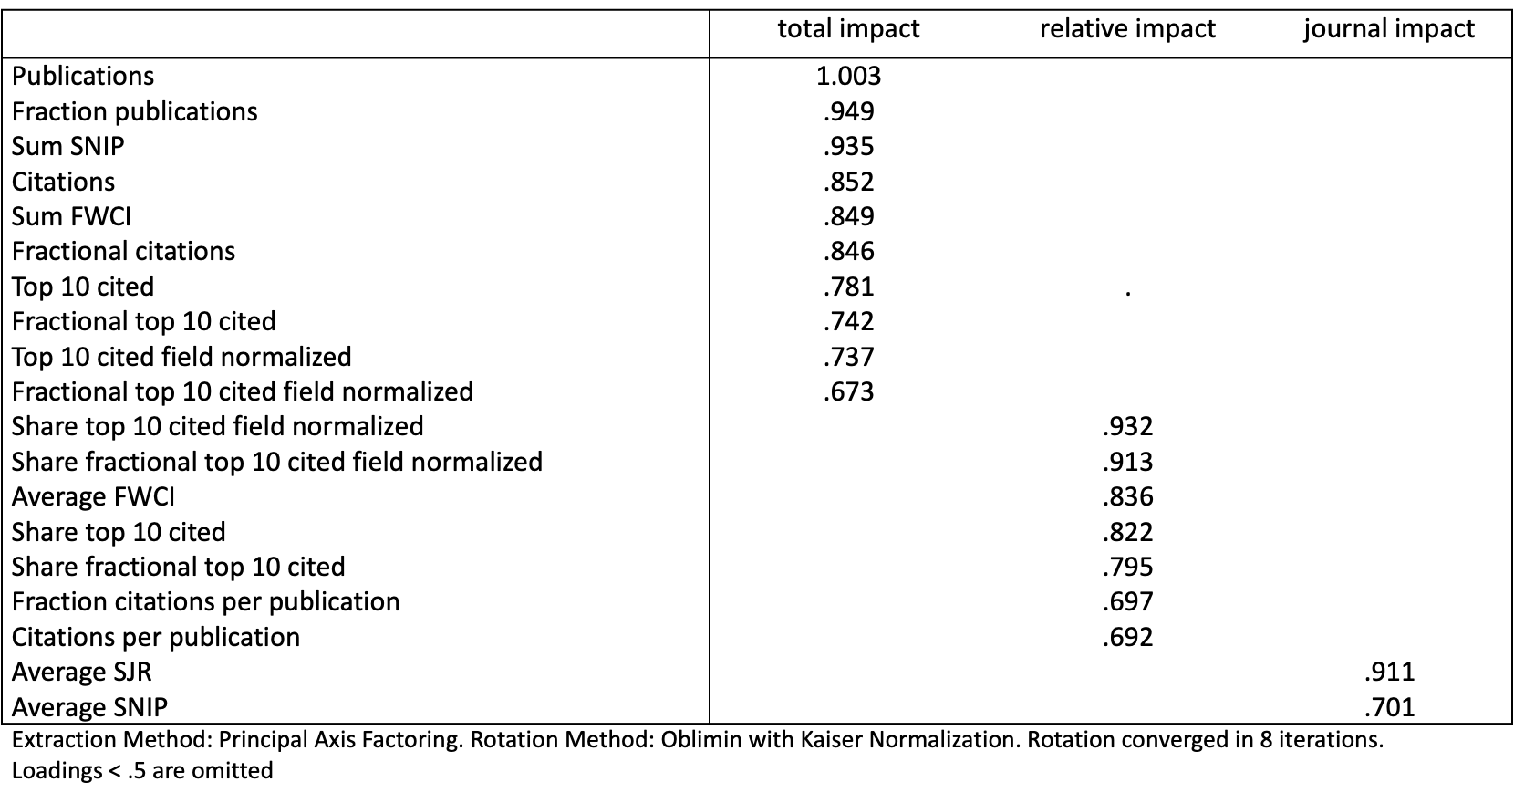
a) Measuring contributions to science
Bibliometric indicators as items
Factor analysis
Reliability
Stable outcome over data sets
Total impact =
Impact as contributions
Impact as influential contributions
Works well in analysis
Notes:
Independence also with more items
Unobservable characteristics
Need operationalization and data
Often it is not more than concepts
Central role RFOs, supported in the community

Slide 10
b) Bias in rewards and recognition
Case: cum laude for PhD thesis
about 5% of all – highly selective
two third are male
Based on the quality?
of the thesis
of the PhD student
That seems not the case
controlling for merit variables, the gender difference remains the same
Next slide shows the findings

Slide 11
Cum laude by gender, faculty and quality*
 | B | S.E. | Wald | df | Sig. | Exp(B) | 95% C.I.for EXP(B)
 |  |  |  |  |  |  | Lower | Upper
women versus men | -0.714 | 0.228 | 9.824 | 1 | 0.002 | 0.49 | 0.313 | 0.765
faculty |  |  | 33.673 | 5 | 0
faculty(1) | -0.702 | 0.258 | 7.373 | 1 | 0.007 | 0.496 | 0.299 | 0.823
faculty(2) | -1.806 | 0.402 | 20.154 | 1 | 0 | 0.164 | 0.075 | 0.362
faculty(3) | 0.004 | 0.268 | 0 | 1 | 0.988 | 1.004 | 0.594 | 1.697
faculty(4) | -1.677 | 0.495 | 11.462 | 1 | 0.001 | 0.187 | 0.071 | 0.494
faculty(5) | -1.125 | 0.764 | 2.164 | 1 | 0.141 | 0.325 | 0.073 | 1.453
PhD year | -0.041 | 0.024 | 2.967 | 1 | 0.085 | 0.96 | 0.916 | 1.006
relative ipact (PhD period) | 0.02 | 0.1 | 0.042 | 1 | 0.838 | 1.021 | 0.839 | 1.241
total impact (PhD period) | 0.465 | 0.066 | 49.777 | 1 | 0 | 1.592 | 1.399 | 1.812
journal impact (PhD period) | 0.474 | 0.093 | 26.051 | 1 | 0 | 1.606 | 1.339 | 1.926
Constant | -2.143 | 0.265 | 65.64 | 1 | 0 | 0.117
Logistic regression; all PhD students in the selected faculties; *Impact calculated over the t-3 ~ t+3 period; N=2579; Nagelkerke R Square: 0.177

Slide 12
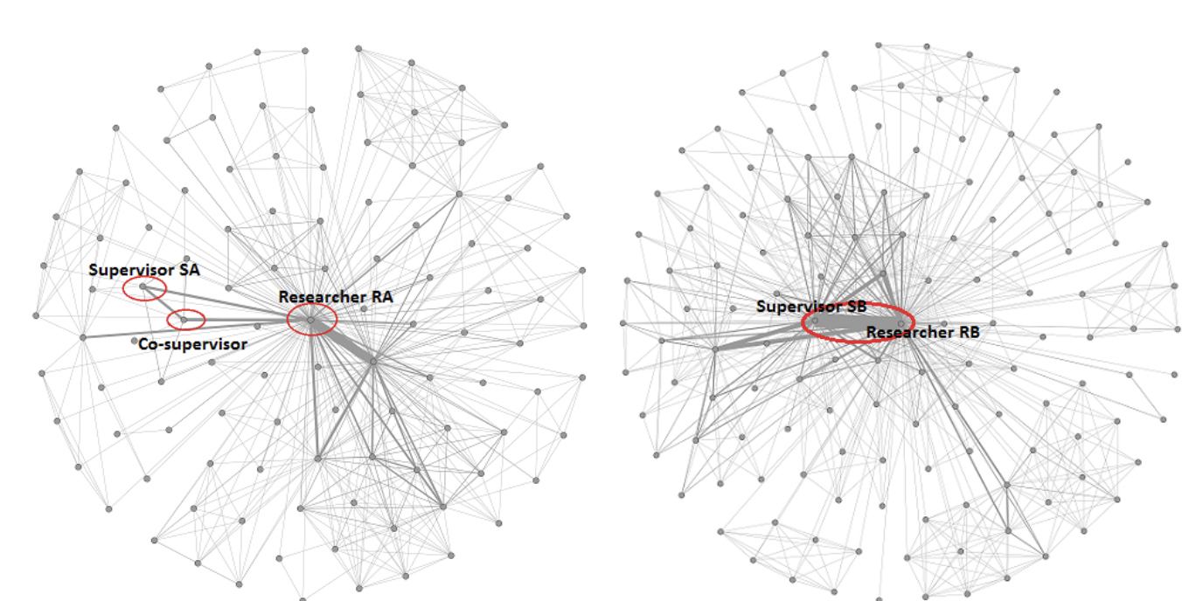
c) Independence
Independence
From the early research environment
To building up an own agenda
Aspects of independence
Former supervisor’s place in the ego network of the researcher
Papers without the supervisor
Research topics without supervisor
Results
Works as expected: increasing average independence through the career.
But not uniformly

Slide 13
d) Cognitive mobility
Concept
Entering over time into new research fields/topics
Data
Scival (Scopus) topic classification
Comparing covered topics per career phase
Questions:
Cognitive mobility in career phases
Effect of cognitive mobility career
Gender differences
Notes:
Results
STI paper
Adds to the evaluation indicators portfolio

Slide 14
e) Gender stereotyping
Detecting gender stereotyping in review reports
Linguistic analysis
Based on word categories
Gendered language can be identified
Mediates the effect of gender on the panel scores

Slide 15
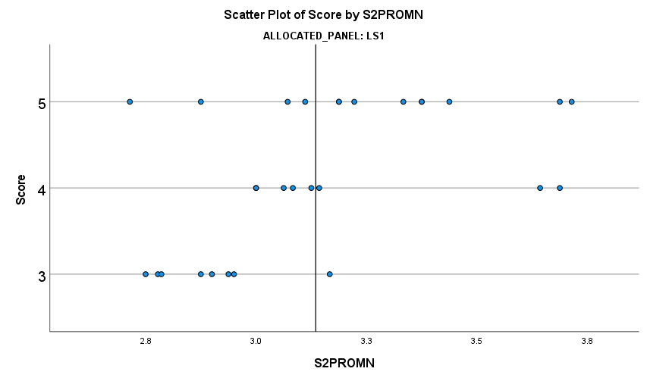
f) Self-presentation
Self-presentation in the interview has a strong effect on the ranking
Van Arensbergen et al., HEP 2013
Analyzing project proposal text
Some gender differences in language use between men and women
Example, one panel:
Project proposal length and the share of ‘non-technical words’ show significant gender differences
Both benefitting men.
Approx. 64% of the effect of gender is mediated through language use.
g
g
ping
ping
ping

Slide 16
3. Issues when studying gender bias in grant allocation
Heterogeneity:
Grants for more fields
Panels covering more fields
Different grant types included
Applicants differ in many respects
analyze homogeneous panels
problem: N
Female vs male applications
Individual career grants
Mixed gender applicant teams
Applicant configurations
v, m, vm, vvv, vvm, vmm, mmm, etc.
Small samples
Low power
Analyze patterns in non-significant findings
Including relevant covariates
Are these available?
Good arguments why not needed?
Direct and indirect bias

Slide 17
Direct and indirect effects
gender
Direct effect
merit / performance
work situation
scores / decision
gender
Private situation
other relevant variables
Indirect effect

Slide 18
How to handle indirect effects?
Without studying the mechanisms directly, one can include them through mediation analysis.
The mechanisms are an interesting subject for studying
Outside the scope of GRANteD.

Slide 19
4. Gender bias in grant allocation?
GRANteD: twelve cases in six countries
Austria: FWF
Germany: DFG; HF
Ireland: STI
Spain: Galicia
Sweden: VR-MH (WP3); VR-NAT & Formas (WP3); MRC; SRC-med; SRC
The Netherlands: NWO Veni; 2000/2005 cohort (WP3)
Two large reference studies

Slide 20
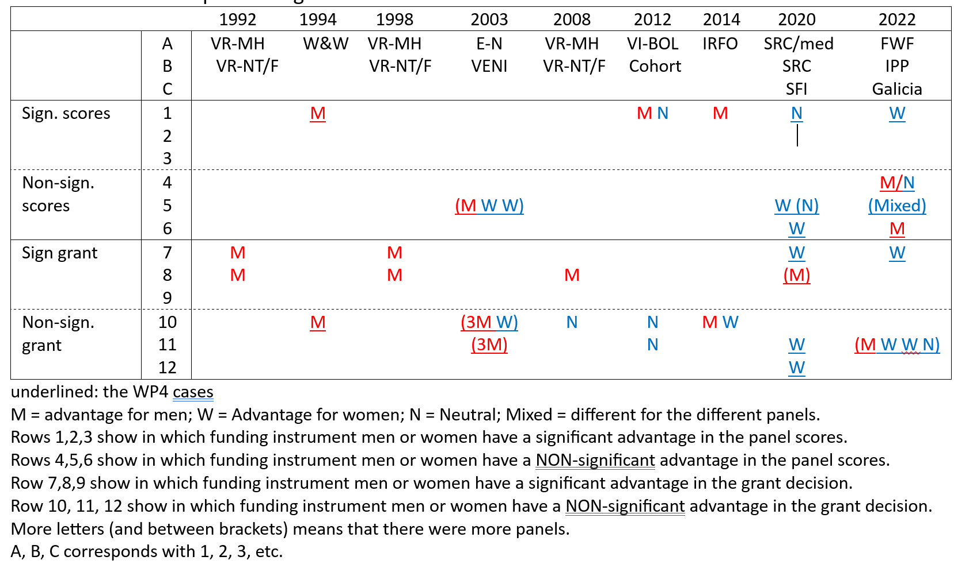
Bias in grant evaluation and decision
Notes:
E = equal
D = different => interactie bij prsy NWO

Slide 21
Findings
Using a large set of different cases over a long period:
bias in favor of men tends to disappear
in the scores and in the grant decisions
some advantages for women
Where tested: hardly indirect gender effects
generational issue:
most GRANteD cases are about early career grants
At micro level, panel differences still exist (the mixed findings)
What needs to be explained?
differences at panel level
change over time

Slide 22
Panel differences
Panel characteristics influencing panel scores
Demography
Share of women
Experience
International members
Level of gender stereotyping
Need more panels to investigate this than were available
With data about the same variables

Slide 23
Different criteria applied for men and women
Meritocracy works for women
the R² for our meritocratic model: men = .09; women = .34
Different evaluation criteria
women become prof when they perform, men become prof
on ‘expected’ performance?
not all, but more often than women
Women
Men

Slide 24
Explanations
Decline of stereotyping in panels
Decline bias
Changing opinions about m/w
Policies
Effect of policy interventions?
Gradual change in opinions about the roles of men and women in society?
Differences between panels?
or
Changing opinions about m/w
Policies
Decline of stereotyping
Decline bias
or/ and
Panel characteristics
Structure
Experience
Gender stereotyping
Disciplines
Level and direction of bias in panels

Slide 25
Main conclusions
Findings
Issues
Gender bias and grants
overall gender bias has almost disappeared in the recent cases
micro level panel differences remain
indirect effects were sparse
But we found is considerable gender bias in
awards and recognition (D4.1)
careers (D3.3) => session 3 tomorrow
Sample size and heterogeneity
larger studies needed (big data)
Other ways of analysing
moderation, longitudinal approaches, experiments, multi-level
Results conditional on used criteria
additional merit dimensions?
definitions & operationalizations lacking
crucial for research and for valid selection

